Slide 1
Interest & Dividends
Pub 17, Chapters 7 & 8
Pub 4012, Tab D
(Federal 1040-Lines 8a-9b)
(NJ 1040-Lines 15a, 15b, 16)
Notes:
1

Slide 2
Interest Income
Interest Income
Income from banks & credit unions, CDs or bonds
Interest income is unearned income
When to report?
Report interest in year earned
In case of bond purchased at discount, increase in value is taxable in year of increase
Notes:
2

Slide 3
Interest Income
(cont’d)
End-of-year tax statements (for amounts > $10)
1099-INT
Bank Statement
1099-OID Original Issue Discount
1099-INT (Brokerage Statement)
Schedule K-1
Where to report?
Enter on TaxWise Interest Statement
Flows through to Sch B & 1040 Lines 8a & 8b
If Sch B is red in Forms Tree, must enter questions about Foreign Accounts and Trusts at bottom of screen
Also flows to NJ-1040 15a & 15b
Notes:
Most banks/financial institutions do not generate a tax statement for under $10
3

Slide 4
Federal Tax-Exempt Interest
Generally bonds issued by:
State/political subdivisions (county or city)
District of Columbia
U.S. possessions & political subdivisions
Savings bonds used for education (Form 8815)
NJ does not always follow Federal taxability rules for interest
See NJ GIT-5 for list
Notes:
4

Slide 5
When is Interest Tax Free?
Interest Type | Exempt From Federal Tax | Exempt From NJ Tax
Interest from U.S. Savings Bonds |  | √
Interest from NJ state/municipal bonds | √ | √
Interest from state/municipal bonds other than NJ | √
Notes:
5

Slide 6
Sample 1099-INT
2011
2014
Douglas Davis
201 Main Street
Notes:
This is a sample of the source document for Interest Income
Notice that Box 1 & 3 are both populated on this sample 1099-INT. Easiest to do this on 2 lines in TW
Tax-exempt interest in Box 8 is for a NJ bond
6

Slide 7
Sample Bank Statement
2014
Douglas Davis
210 Main Street
Bridgewater, NJ 08807
99-2222222
2014
45.00
Notes:
This is another way Interest Income may be reported by a bank
7

Slide 8
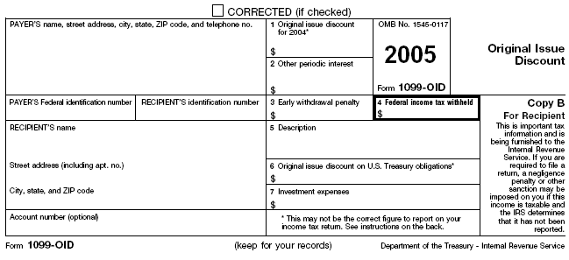
Sample Original Issue Discount Interest (OID)
2014
Enter as Ordinary
Interest
Notes:
This is a sample of how Original Issue Discount is reported
Enter as Ordinary Interest
8

Slide 9
Sample 1099-INT (Brokerage)
2014 Interest Income

Slide 10
TW Interest Statement
Notes:
Pull up TW Interest Stmt screen
Link from Line 8a on 1040 Page 1 (using arrow or F9), which takes you to Schedule B Interest & Ordinary Dividends screen. Then link from Line 1b to Interest Statement OR
Go directly to Interest Received screen by clicking on Interest Stmt in Forms Tree
Enter Payer’s Name (abbreviate as necessary to fit)
Enter amount from 1099-INT Box 1 or 3 in Box 1 or 3 column
Since both Boxes 1 & 3 were populated on sample 1099-INT, it is easier to enter them on 2 separate lines on the TW Interest Statement
In TSJ field, Enter T if 1099 belongs to taxpayer, S for spouse, J if joint names
Enter amount from Box 8 in NAEOB amount column along with appropriate code
N – nominee interest – interest transferred to another person
A - accrued interest – interest paid to seller at time of purchase
E - Federal tax exempt interest
O - OID - generally not used since most interest reported on Form 1099-OID is fully taxable & should be entered as ordinary interest; for OID interest that is fully taxable, make no entry in NAEOB
B – Amortized bond premium
AMT PAB field – OUT OF SCOPE
Enter amount from 1099-INT Box 2 in Early penalty column
Enter amount from 1099-INT Box 4 in Federal withheld column (from box 3 on 1099 INT)
If state law treats interest differently than Federal, enter an adjustment in State Adjust column
Interest from US government bonds – taxable on Federal, tax exempt NJ (- adjustment)
Interest from NJ municipal bonds – tax exempt both (E in NAEOB, no adjustment)
Interest from other states’ bonds – tax exempt Federal, taxable NJ (E in NAEOB, + adjustment)
Info from Interest Statement screen flows through to Schedule B & to 1040 Lines 8a Taxable Interest & 8b Tax-Exempt Interest and then to NJ 1040 Lines 15a Taxable Interest and 15b Tax-Exempt Interest
Do not allow blank lines between entries
10

Slide 11
TW-Interest Statement Data Sources for Fields
Pub 4012 Tab D
TW Field | From 1099-INT
Payer’s Name | Enter data as per Interest statement (abbreviate as necessary)
Box 1 or 3 Amount | Enter amount from 1099-INT Box 1 or 3
TSJ | Enter T if 1099 belongs to taxpayer, S for spouse, J if joint names
State Adjustment Amount | If state law treats interest differently than Federal, enter an adjustment in State Adjust column
NAEOB Code | Enter as per NAEOB Field Values (E for Exempt)
NAEOB Amount | Enter amount from 1099-INT Box 8 (Tax-exempt interest)
AMT PAB | Private Activity Bond interest - Out of Scope
Early Penalty | Enter amount from 1099-INT Box 2
Federal Withheld | Enter amount from 1099-INT Box 4
Notes:
For student reference only
11

Slide 12
Federal/State Differences: Interest on Interest Statement
ITEM | FEDERAL | STATE | COUNSELOR ACTION
US Treasury obligations | Taxable | Tax-exempt | Enter in Box 1. Enter negative amount in State Adjust field
NJ State bonds | Tax-exempt | Tax-exempt | Enter E & amount in NAEOB field. Enter nothing in State Adjust field
State bonds other than NJ | Tax-exempt | Taxable | Enter E & amount in NAEOB field. Enter positive amount in State Adjust field
Notes:
12

Slide 13
Interest & Dividends – TW Tip
Always enter interest and dividend as though there is only a federal return.
This entry is transferred directly to the NJ return
Then ask “Is this treated differently on the state return.” If yes, adjust with a + or – in the State adjust column

Slide 14
Interest on Interest Statement
2014
Notes:
14

Slide 15
Interest – NAEOB Field Values
Pub 4012 Tab D
Nominee – Interest transferred to, & taxable to, 3rd party
Accrued – Interest accrued for bonds purchased between interest payment dates included in purchase price, not income
Exempt from Federal Tax – Interest on state, county or city bonds (political subdivisions)
OID – Interest received previously included in taxable income (rarely seen)
Bond – Amortized Bond Premium – Adjustment to total OID received
NOTE: Only use E code; refer other codes to experienced counselor
Notes:
These values are where NAEOB comes from
The only one we really use is E
15

Slide 16
1099-INT on Brokerage Statement
Summary of potentially many individual transactions
Only Summary values need to be entered on TW Interest Stmt (use name of Brokerage)
Detail transactions usually listed later on statement
If there is a tax-exempt interest amount (Box 8), then full amount is tax-exempt federally, but you may need to examine detail to determine how much is tax-exempt for New Jersey
Tax-exempt mutual funds should have a breakdown of tax-exempt percentages by state

Slide 17
Seller-Financed Mortgage Interest
May receive interest if home purchaser privately finances the mortgage
Enter seller-financed mortgage interest directly on Schedule B Section 1a (not on Interest Statement)
Enter buyer’s name, address, Social Security #, and amount of interest
Notes:
17

Slide 18
TW-Seller-Financed Mortgage Interest
Buyer’s Name, SS #, Address, & Interest Income
Notes:
18

Slide 19
Dividends
Pub 4012 Tab D
Dividends
Part of the earnings of a corporation that is distributed to its shareholders
Unearned income
Ordinary and Qualified dividends segregated (different tax rates)
End-of-year tax statement:
1099-DIV Statement OR Brokerage Statement
Where to report?
Enter on TaxWise Dividend Statement
Flows through to Sch B & 1040 Lines 9a & 9b and NJ 1040 Line 16
If Sch B is red in Forms Tree, must enter questions about Foreign Accounts and Trusts at bottom of screen
Notes:
19

Slide 20
Sample 1099-DIV
2014
Enter Foreign Tax Paid on
Form 1116
Diane Davis
Enter Foreign Tax Paid
Non-Dividend Distribution is return of principal.
Do not enter into TW
201 Main Street
NOTE: Box 3, Non-Dividend Distribution, is a return of principal; not taxed until
all cost is recovered. Reduce cost by these distributions at time of sale
Notes:
This is a sample of how Dividends are reported
Non Dividend Distribution may appear on 1099-Div
Represents return of cost basis
Not taxed until total cost is recovered and investment is sold
At time of sale, reduce cost by amount of non dividend distribution to calculate gain/loss
20

Slide 21
Sample 1099-DIV (Brokerage)
2014 Dividends and Distributions

Slide 22
TW-Dividend Statement
Ordinary
Dividends
Capital Gains
Distribution
Qualified Dividends
Notes:
Pull up TW Dividend Stmt screen
Link from Line 9a on 1040 Page 1 (using arrow or F9), which takes you to Schedule B Interest & Ordinary Dividends screen. Then link from Line 5a to Dividend Income screen OR
Go directly to Dividend Income screen by clicking on Dividend Stmt in Forms Tree
Enter Payer name (abbreviate as needed to fit)
Enter amount from 1099-DIV Box 1a in Ordinary dividends column
Enter amount from 1099-DIV Box 1b in Qualified dividends column
Enter T if 1099 belongs to taxpayer, S for spouse, J if joint names
Enter amount from 1099-DIV Box 2a in Capital Gains column. Will flow through to Schedule D, line 13
Enter amount from 1099-DIV Box 2b in 1250 gain column
Enter amount from 1099-DIV Box 4 in Federal Withheld column
Enter exempt interest dividends received from a mutual fund in Exempt interest dividends column (do not include this amount in Ordinary dividends column). This amount flows to the 1040 line 8b (tax exempt interest).
Note that Non-Dividend Distributions are not entered on TW Dividend Statement screen at all. They are a return of your cost basis & are not taxed until all cost is recovered. Reduce your cost by the amount of Non-Dividend Distributions received when you sell the investment
When AMT PAB causes Alternate Minimum Tax, then return it is out of scope
22

Slide 23
Data Sources of Dividend Statement Fields
Pub 4012 Tab D
TW Field | From 1099-DIV
Payer’s name | Enter data as per Dividend statement (abbreviate as necessary to fit)
Ordinary dividends | Enter amount from 1099-DIV Box 1a
Qualified dividends | Enter amount from 1099-DIV Box 1b
TSJ | Enter T if 1099 belongs to taxpayer, S for spouse, J if joint names
State adj. | Enter an adjustment if state & federal tax laws treat dividends differently
N | Nominee (not taxable)
Capital gain | Enter amount from 1099-DIV Box 2a
1250 gain | Enter amount from 1099-DIV Box 2b (not used)
28% gain | Enter amount from 1099-DIV Box 2d
Fed with. | Enter amount from 1099-DIV Box 4
Exempt Int. Div. | Enter exempt interest dividend received from a mutual fund (do not include this amount in Ordinary dividends column)
AMT PAB | Exempt interest dividend from private activity bonds – may be Out of Scope
Notes:
For student reference only
23

Slide 24
TW DIVIDEND STATEMENT – Flows to 1040 Line 9
Pub 4012 Tab D

Slide 25
1099-DIV on Brokerage Statement
Summary of potentially many individual transactions
Only Summary values need to be entered on TW Dividend Stmt (use name of Brokerage)
Detail transactions usually listed on later pages in statement

Slide 26
Exempt Interest Dividends from Mutual Funds
Tax exempt on Federal return
Taxability varies for NJ, depending on bonds held by fund (look at statement detail pages)
Interest attributable to Federal obligations (including P.R., territories, etc.) always tax exempt
Interest attributable to other states except NJ always taxable
Interest attributable to NJ bonds only tax exempt if fund is “NJ Qualified Investment Fund” (usually has NJ in name of fund)
Interest on NJ bonds held individually by taxpayer (not in a mutual fund) always tax exempt

Slide 27
TW – Entering Exempt Interest Dividends
Enter full amount of Exempt Interest Dividends from Box 10 into Exempt Int. Div. column on 1099DIV screen
Brokerage statement usually provides percentages of bonds in different categories (i.e. – Federal, each state). Apply those percentages to Exempt Interest Dividends amount as appropriate
If Federal or multi-state fund, add “+” all non-Federal amounts (including NJ amounts) to State Adjust column
If fund is NJ specific, add “+” only All other states amount to State Adjust column

Slide 28
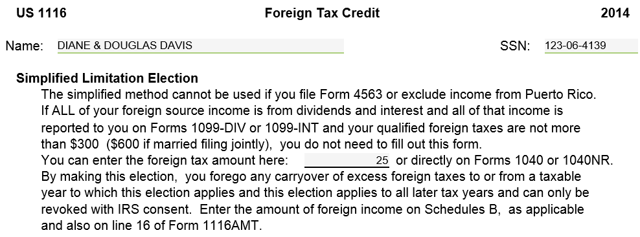
TW Form 1116 - Foreign Tax Paid
Pub 4012 Tab G
Foreign Tax Paid
Notes:
Foreign tax paid may be on the 1099 B brokerage statement
Add form 1116 Foreign Tax Credit to forms tree and click on it OR
Link from 1040 page 2 Line 47 to Form 1116
Enter the foreign tax credit amount to the box in the center of the paragraph on the top of the form
If the total amount of foreign tax credit are more than $300 ($600 MFJ) the return is Out of Scope
Do not complete any other fields on this form even if they are red
The amount entered will go to 1040, Page 2, Line 47 as a non-refundable credit
28

Slide 29
Interest & Dividends Reported on Schedule K-1 (Partner’s Share of Income)
Schedule K-1 is In Scope only if there are just Interest, Dividend, Capital Gains or Royalties
Always check with experienced counselor for all K-1s
Handling of Capital Gains & Royalties are covered in separate modules
Enter Interest and/or Dividends directly on Interest or Dividend Statement - do not prepare or make entries on Form K-1
Include “K-1” in Payer field
See Special Topic document “K-1 Income Entry” located on the TaxPrep4Free.org Preparer page
Notes:
29

Slide 30
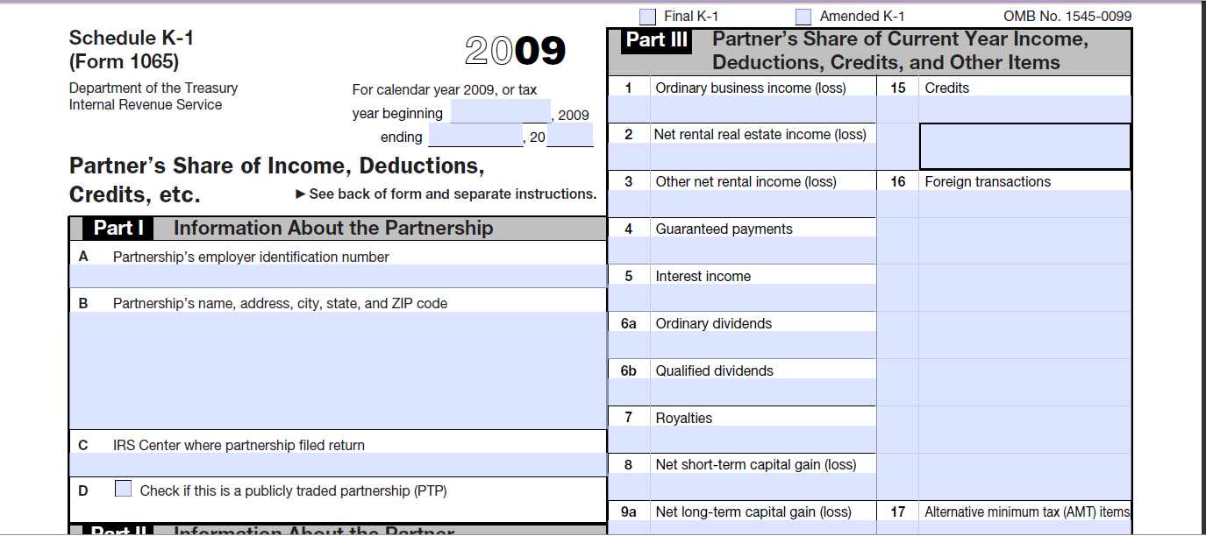
Sample K-1 Interest & Dividends From Schedule K-1
2014
Interest, Dividends, Capital Gains, Royalties
are only Partnership Income in Scope
Notes:
30

